Slide 1


Slide 2

Card players all know how to sort …
  First card is already sorted
  With all the rest,
    Scan back from the end until you find the first card larger than the new one,
    Move all the lower ones up one slot
    insert it
✰
★
A
★
K
★
10
★
2
✦
J
✦
2
•

2
◻
Q

9

9


Slide 3

Complexity
  For each card
      Scan O(n)
      Shift up O(n)
      Insert O(1)
      Total O(n)
  First card requires O(1), second O(2), …
  For n cards operations ⬅ O(n²)
n
Σ i
i=1

Slide 4
Complexity
  For each card
      Scan O(n) O(log n)
      Shift up O(n)
      Insert O(1)
      Total O(n)
  First card requires O(1), second O(2), …
  For n cards operations ⬅ O(n²)
Use binary search!
Unchanged!
Because the
shift up operation
still requires O(n)
time
n
Σ i
i=1

Slide 5

A challenge for you
  The code in the notes (and on the Web) has an error
  First person to email a correct version
  gets up to 2 extra marks added to their final mark if that would move them up a grade!
    ie if you had x8% or x9%, it goes to (x+1)0%
  To qualify, you need to point out the error in the original, as well as supply a corrected version!

Slide 6

From the first element
  Exchange pairs if they’re out of order
    Last one must now be the largest
  Repeat from the first to n-1
  Stop when you have only one element to check

Slide 7

/* Bubble sort for integers */
#define SWAP(a,b) { int t; t=a; a=b; b=t; }
void bubble( int a[], int n ) {
int i, j;
for(i=0;i<n;i++) { /* n passes thru the array */
/* From start to the end of unsorted part */
for(j=1;j<(n-i);j++) {
/* If adjacent items out of order, swap */
if( a[j-1]>a[j] ) SWAP(a[j-1],a[j]);
}
}
}

Slide 8

/* Bubble sort for integers */
#define SWAP(a,b) { int t; t=a; a=b; b=t; }
void bubble( int a[], int n ) {
int i, j;
for(i=0;i<n;i++) { /* n passes thru the array */
/* From start to the end of unsorted part */
for(j=1;j<(n-i);j++) {
/* If adjacent items out of order, swap */
if( a[j-1]>a[j] ) SWAP(a[j-1],a[j]);
}
}
}
O(1) statement

Slide 9
/* Bubble sort for integers */
#define SWAP(a,b) { int t; t=a; a=b; b=t; }
void bubble( int a[], int n ) {
int i, j;
for(i=0;i<n;i++) { /* n passes thru the array */
/* From start to the end of unsorted part */
for(j=1;j<(n-i);j++) {
/* If adjacent items out of order, swap */
if( a[j-1]>a[j] ) SWAP(a[j-1],a[j]);
}
}
}
O(1) statement
Inner loop
n-1, n-2, n-3, … , 1 iterations

Slide 10
/* Bubble sort for integers */
#define SWAP(a,b) { int t; t=a; a=b; b=t; }
void bubble( int a[], int n ) {
int i, j;
for(i=0;i<n;i++) { /* n passes thru the array */
/* From start to the end of unsorted part */
for(j=1;j<(n-i);j++) {
/* If adjacent items out of order, swap */
if( a[j-1]>a[j] ) SWAP(a[j-1],a[j]);
}
}
}
Outer loop n iterations

Slide 11
/* Bubble sort for integers */
#define SWAP(a,b) { int t; t=a; a=b; b=t; }
void bubble( int a[], int n ) {
int i, j;
for(i=0;i<n;i++) { /* n passes thru the array */
/* From start to the end of unsorted part */
for(j=1;j<(n-i);j++) {
/* If adjacent items out of order, swap */
if( a[j-1]>a[j] ) SWAP(a[j-1],a[j]);
}
}
}
Overall
1
n(n+1)
Σ i
=
= O(n²)
i=n-1
2
n outer loop iterations
inner loop iteration count

Slide 12

Bubble sort
  O(n²)
  Very simple code
Insertion sort
  Slightly better than bubble sort
    Fewer comparisons
  Also O(n²)
But HeapSort is O(n log n)
Where would you use bubble or insertion sort?

Slide 13

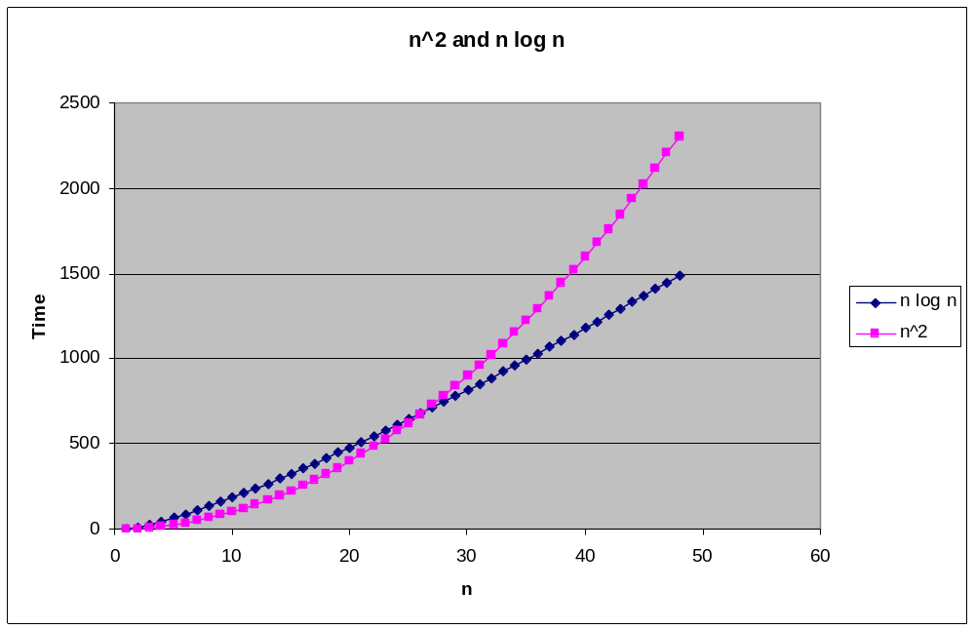
Bubble Sort or Insertion Sort
  Use
  when n
  is small
  Simple code
  compensates
  for low
  efficiency!

Slide 14

Efficient sorting algorithm
  Discovered by C.A.R. Hoare
Example of Divide and Conquer algorithm
Two phases
  Partition phase
    Divides the work into half
  Sort phase
    Conquers the halves!

Slide 15
Partition
  Choose a pivot
  Find the position for the pivot so that
    all elements to the left are less
    all elements to the right are greater
< pivot
pivot
> pivot

Slide 16
Conquer
  Apply the same algorithm to each half
< pivot
> pivot
< p’
p’
> p’
pivot
< p”
p”
> p”

Slide 17
Implementation
quicksort( void *a, int low, int high )
{
int pivot;
/* Termination condition! */
if ( high > low )
{
pivot = partition( a, low, high );
quicksort( a, low, pivot-1 );
quicksort( a, pivot+1, high );
}
}
Divide
Conquer

Slide 18

int partition( int *a, int low, int high ) {
int left, right;
int pivot_item;
pivot_item = a[low];
pivot = left = low;
right = high;
while ( left < right ) {
/* Move left while item < pivot */
while( a[left] <= pivot_item ) left++;
/* Move right while item > pivot */
while( a[right] >= pivot_item ) right--;
if ( left < right ) SWAP(a,left,right);
}
/* right is final position for the pivot */
a[low] = a[right];
a[right] = pivot_item;
return right;
}

Slide 19
This example
uses int’s
to keep things
simple!
int partition( int *a, int low, int high ) {
int left, right;
int pivot_item;
pivot_item = a[low];
pivot = left = low;
right = high;
while ( left < right ) {
/* Move left while item < pivot */
while( a[left] <= pivot_item ) left++;
/* Move right while item > pivot */
while( a[right] >= pivot_item ) right--;
if ( left < right ) SWAP(a,left,right);
}
/* right is final position for the pivot */
a[low] = a[right];
a[right] = pivot_item;
return right;
}
Any item will do as the pivot,
choose the leftmost one!
23
12
15
38
42
18
36
29
27
low
high

Slide 20
int partition( int *a, int low, int high ) {
int left, right;
int pivot_item;
pivot_item = a[low];
pivot = left = low;
right = high;
while ( left < right ) {
/* Move left while item < pivot */
while( a[left] <= pivot_item ) left++;
/* Move right while item > pivot */
while( a[right] >= pivot_item ) right--;
if ( left < right ) SWAP(a,left,right);
}
/* right is final position for the pivot */
a[low] = a[right];
a[right] = pivot_item;
return right;
}
Set left and right markers
left
right
23
12
15
38
42
18
36
29
27
low
pivot: 23
high

Slide 21
int partition( int *a, int low, int high ) {
int left, right;
int pivot_item;
pivot_item = a[low];
pivot = left = low;
right = high;
while ( left < right ) {
/* Move left while item < pivot */
while( a[left] <= pivot_item ) left++;
/* Move right while item > pivot */
while( a[right] >= pivot_item ) right--;
if ( left < right ) SWAP(a,left,right);
}
/* right is final position for the pivot */
a[low] = a[right];
a[right] = pivot_item;
return right;
}
Move the markers
until they cross over
left
right
23
12
15
38
42
18
36
29
27
low
pivot: 23
high

Slide 22
int partition( int *a, int low, int high ) {
int left, right;
int pivot_item;
pivot_item = a[low];
pivot = left = low;
right = high;
while ( left < right ) {
/* Move left while item < pivot */
while( a[left] <= pivot_item ) left++;
/* Move right while item > pivot */
while( a[right] >= pivot_item ) right--;
if ( left < right ) SWAP(a,left,right);
}
/* right is final position for the pivot */
a[low] = a[right];
a[right] = pivot_item;
return right;
}
Move the left pointer while
it points to items <= pivot
left
right
Move right
similarly
23
12
15
38
42
18
36
29
27
low
pivot: 23
high

Slide 23
int partition( int *a, int low, int high ) {
int left, right;
int pivot_item;
pivot_item = a[low];
pivot = left = low;
right = high;
while ( left < right ) {
/* Move left while item < pivot */
while( a[left] <= pivot_item ) left++;
/* Move right while item > pivot */
while( a[right] >= pivot_item ) right--;
if ( left < right ) SWAP(a,left,right);
}
/* right is final position for the pivot */
a[low] = a[right];
a[right] = pivot_item;
return right;
}
Swap the two items
on the wrong side of the pivot
left
right
23
12
15
38
42
18
36
29
27
pivot: 23
low
high

Slide 24
int partition( int *a, int low, int high ) {
int left, right;
int pivot_item;
pivot_item = a[low];
pivot = left = low;
right = high;
while ( left < right ) {
/* Move left while item < pivot */
while( a[left] <= pivot_item ) left++;
/* Move right while item > pivot */
while( a[right] >= pivot_item ) right--;
if ( left < right ) SWAP(a,left,right);
}
/* right is final position for the pivot */
a[low] = a[right];
a[right] = pivot_item;
return right;
}
left and right
have swapped over,
so stop
right
left
23
12
15
18
42
38
36
29
27
low
pivot: 23
high

Slide 25
int partition( int *a, int low, int high ) {
int left, right;
int pivot_item;
pivot_item = a[low];
pivot = left = low;
right = high;
while ( left < right ) {
/* Move left while item < pivot */
while( a[left] <= pivot_item ) left++;
/* Move right while item > pivot */
while( a[right] >= pivot_item ) right--;
if ( left < right ) SWAP(a,left,right);
}
/* right is final position for the pivot */
a[low] = a[right];
a[right] = pivot_item;
return right;
}
right
left
23
12
15
18
42
38
36
29
27
low
pivot: 23
high
Finally, swap the pivot
and right

Slide 26
int partition( int *a, int low, int high ) {
int left, right;
int pivot_item;
pivot_item = a[low];
pivot = left = low;
right = high;
while ( left < right ) {
/* Move left while item < pivot */
while( a[left] <= pivot_item ) left++;
/* Move right while item > pivot */
while( a[right] >= pivot_item ) right--;
if ( left < right ) SWAP(a,left,right);
}
/* right is final position for the pivot */
a[low] = a[right];
a[right] = pivot_item;
return right;
}
right
pivot: 23
18
12
15
23
42
38
36
29
27
low
high
Return the position
of the pivot

Slide 27

pivot
pivot: 23
18
12
15
23
42
38
36
29
27
Recursively
sort left half
Recursively
sort right half

Slide 28

Partition
  Check every item once O(n)
Conquer
  Divide data in half O(log₂n)
Total
  Product O(n log n)
Same as Heapsort
  quicksort is generally faster
    Fewer comparisons
    Details later (and assignment 2!)
But there’s a catch …………….

Slide 29

What happens if we use quicksort
on data that’s already sorted
(or nearly sorted)
We’d certainly expect it to perform well!

Slide 30
Sorted data
pivot
?
1
2
3
4
5
6
7
8
9
< pivot
> pivot

Slide 31
pivot
Sorted data
Each partition
produces
  a problem of size 0
  and one of size n-1!
Number of partitions?
1
2
3
4
5
6
7
8
9
> pivot
pivot
2
3
4
5
6
7
8
9
> pivot

Slide 32
pivot
Sorted data
Each partition
produces
  a problem of size 0
  and one of size n-1!
Number of partitions?
  n each needing time O(n)
  Total nO(n)
  or O(n²)
Quicksort is as bad as bubble or insertion sort
1
2
3
4
5
6
7
8
9
> pivot
pivot
2
3
4
5
6
7
8
9
> pivot

Slide 33
Quicksort’s O(n log n) behaviour
  Depends on the partitions being nearly equal
  there are O( log n ) of them
On average, this will nearly be the case
  and quicksort is generally O(n log n)
Can we do anything to ensure O(n log n) time?
In general, no
  But we can improve our chances!!

Slide 34

Any pivot will work …
Choose a different pivot …
  so that the partitions are equal
  then we will see O(n log n) time
pivot
1
2
3
4
5
6
7
8
9
> pivot
< pivot

Slide 35

Take 3 positions and choose the median
  say … First, middle, last
  median is 5
  perfect division of sorted data every time!
  O(n log n) time
Since sorted (or nearly sorted) data is common,
median-of-3 is a good strategy
  especially if you think your data may be sorted!
1
2
3
4
5
6
7
8
9

Slide 36

Choose a pivot randomly
  Different position for every partition
  On average, sorted data is divided evenly
  O(n log n) time
Key requirement
  Pivot choice must take O(1) time

Slide 37

Never!!
  Any pivot selection strategy
  could lead to O(n²) time
Here median-of-3 chooses 2
  One partition of 1 and
  One partition of 7
Next it chooses 4
  One of 1 and
  One of 5
1
4
9
6
2
5
7
8
3
1
2
4
9
6
5
7
8
3

Slide 38

Sorting
  Bubble, Insert
    O(n²) sorts
    Simple code
    May run faster for small n,
    n ~10 (system dependent)
  Quick Sort
    Divide and conquer
    O(n log n)

Slide 39

Quick Sort
    O(n log n) but ….
    Can be O(n²)
    Depends on pivot selection
      Median-of-3
      Random pivot
      Better but not guaranteed

Slide 40

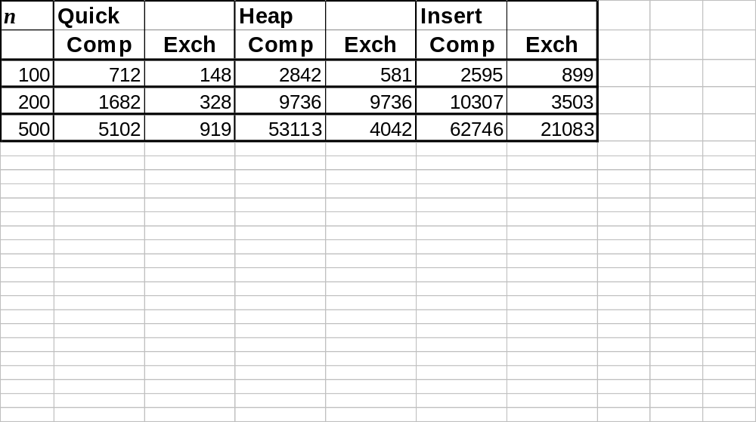
Use Heapsort instead?
Quicksort is generally faster
  Fewer comparisons and exchanges
  Some empirical data

Slide 41
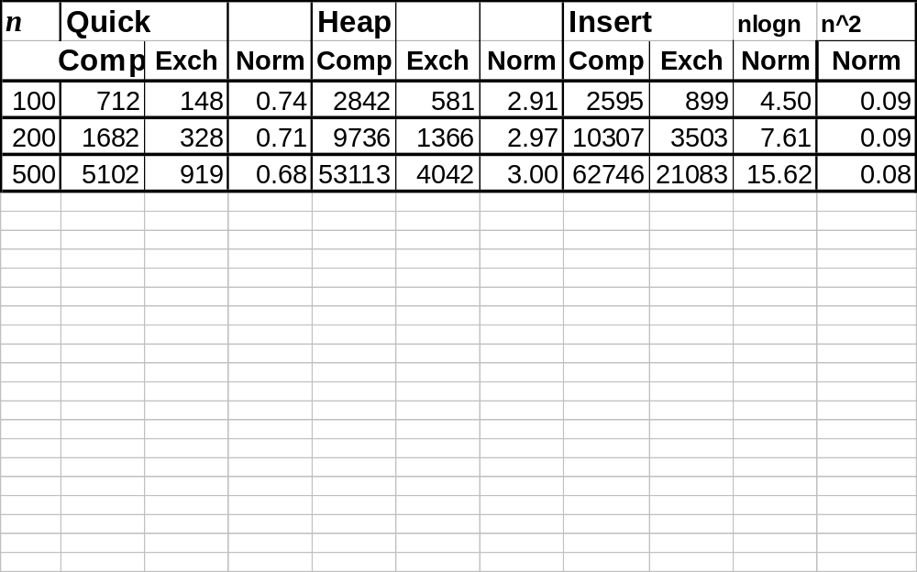
Reporting data
  Normalisation works when you have a hypothesis to work with!
Divide by n log n
Divide by n²

Slide 42

Quicksort
  Generally faster
  Sometimes O(n²)
    Better pivot selection reduces probability
  Use when you want average good performance
    Commercial applications, Information systems
Heap Sort
  Generally slower
  Guaranteed O(n log n) … Can design this in!
  Use for real-time systems
    Time is a constraint

Slide 43

Quicksort
  POSIX standard
void qsort( void *base, size_t n, size_t size,
int (*compar)( const void *, const void * ) );
  base address of array
  n number of elements
  size size of an element
  compar comparison function

Slide 44
Quicksort
  POSIX standard
  Comparison function
  C allows you to pass a function to another function!
void qsort( void *base, size_t n, size_t size,
int (*compar)( const void *, const void * ) );
  base address of array
  n number of elements
  size size of an element
  compar comparison function

